Slide 1
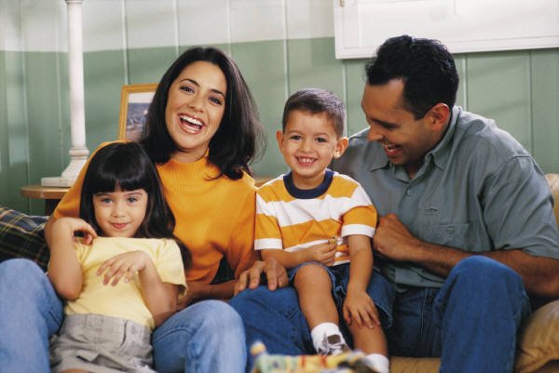
Helping sibling relationships Min Nat
17.2.2017

Slide 2
The benefits of having siblings
Enjoyment of having a sibling:
Someone to play with and to share jokes with
Someone to tease and someone to talk to
Someone who looks out for you and looks after you
A role model
A great friend and a lifelong connection
Lessons of life provided by siblings
Learning to take turns and to wait
Not always being listened to
Not always being center of attention
Having your possessions moved or broken
Being left out
Having to alter or abandon your plans
Learning to get on together
Live with someone who regularly annoys you

Slide 3
Sibling clashes
Allow them to resolve their problems
If argument turn to unkind name-calling or one may get hurt – step in
Teach to share
Take pre-emptive actions
Teach how to express negative emotions

Slide 4
Sibling rivalry
Parents must do all they can to help their feel equally loved and important
Avoid favouritism
Assure your children with words and actions that they each are special
Treat children equally

Slide 5
Tips for building sibling relations
Give child space and some privacy
Do fun things together as family
Allow to play childish games together
Allow play fighting
Affirm each child
Build a sense of love and understanding between them
Be fair
Allow them to express their concerns
Encourage laughter
Praise in private
Appreciate the differences

